Slide 1
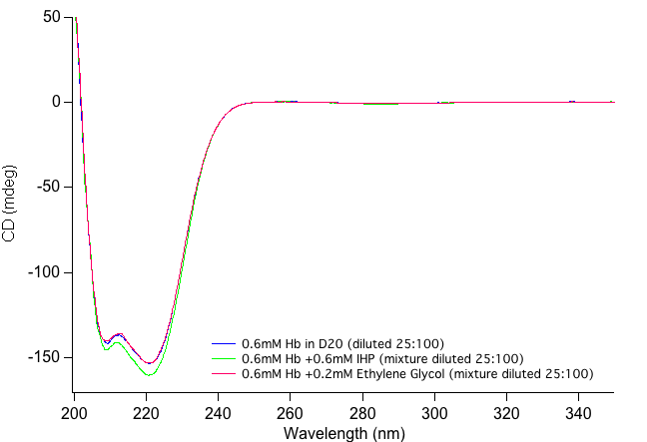
Hb CD Experiments
Notes:
I prepared the stocks under the same conditions as Guifeng’s experiments, but had to dilute the original solution 25:100 to maintain a reasonable voltage. This was done with a 0.1mm cell.

Slide 2
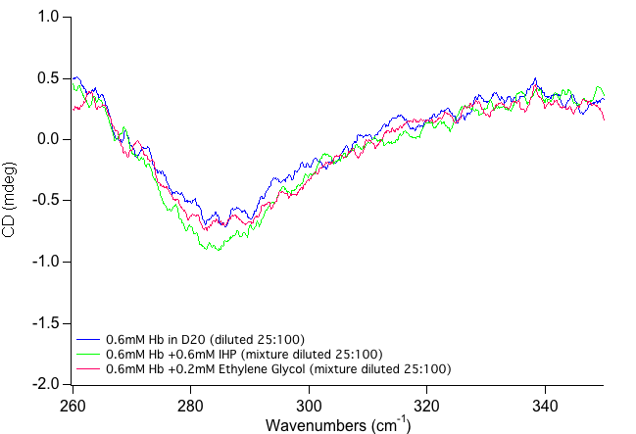
Hb CD Experiments: Zoom

